Slide 1
Challenge 3 Remote access to a wireless sensor network
Team members:
Shisheng wang
xiangtian yi
Ye xing
Yanlin zhou

Slide 2


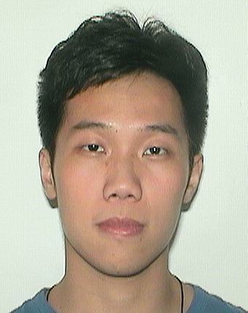

Presenter on this challenge
 | Xiangtian | Shisheng | Ye | Yanlin
Challenge 1 | Presenter
Challenge 2 |  | Presenter
Challenge 3 |  |  | Presenter
Challenge 4 |  |  |  | Presenter
Challenge 5 | Presenter
Challenge 6 |  | Presenter
Challenge 7 |  |  | Presenter
Challenge 8 |  |  |  | Presenter

Slide 3
TEAM WORK
Xiangtian | Shisheng | Ye | Yanlin
I helped designed the circuit, to make every bulb able to lighted; assisted setting the router so that the DDNS can work; besides, I helped debugged the function in HTML to be excuted correctly. | I wrote the arduino code and some of the javascript code to make sure that data could be transfered from leds to webpage or vice versa. | I set up the Raspberry Pi environment. Also solve the DDNS problem with NO-IP and set up the router. | I designed the user interface of the website programmed in html and Javascript and help to implement the data transfer function.

Slide 4

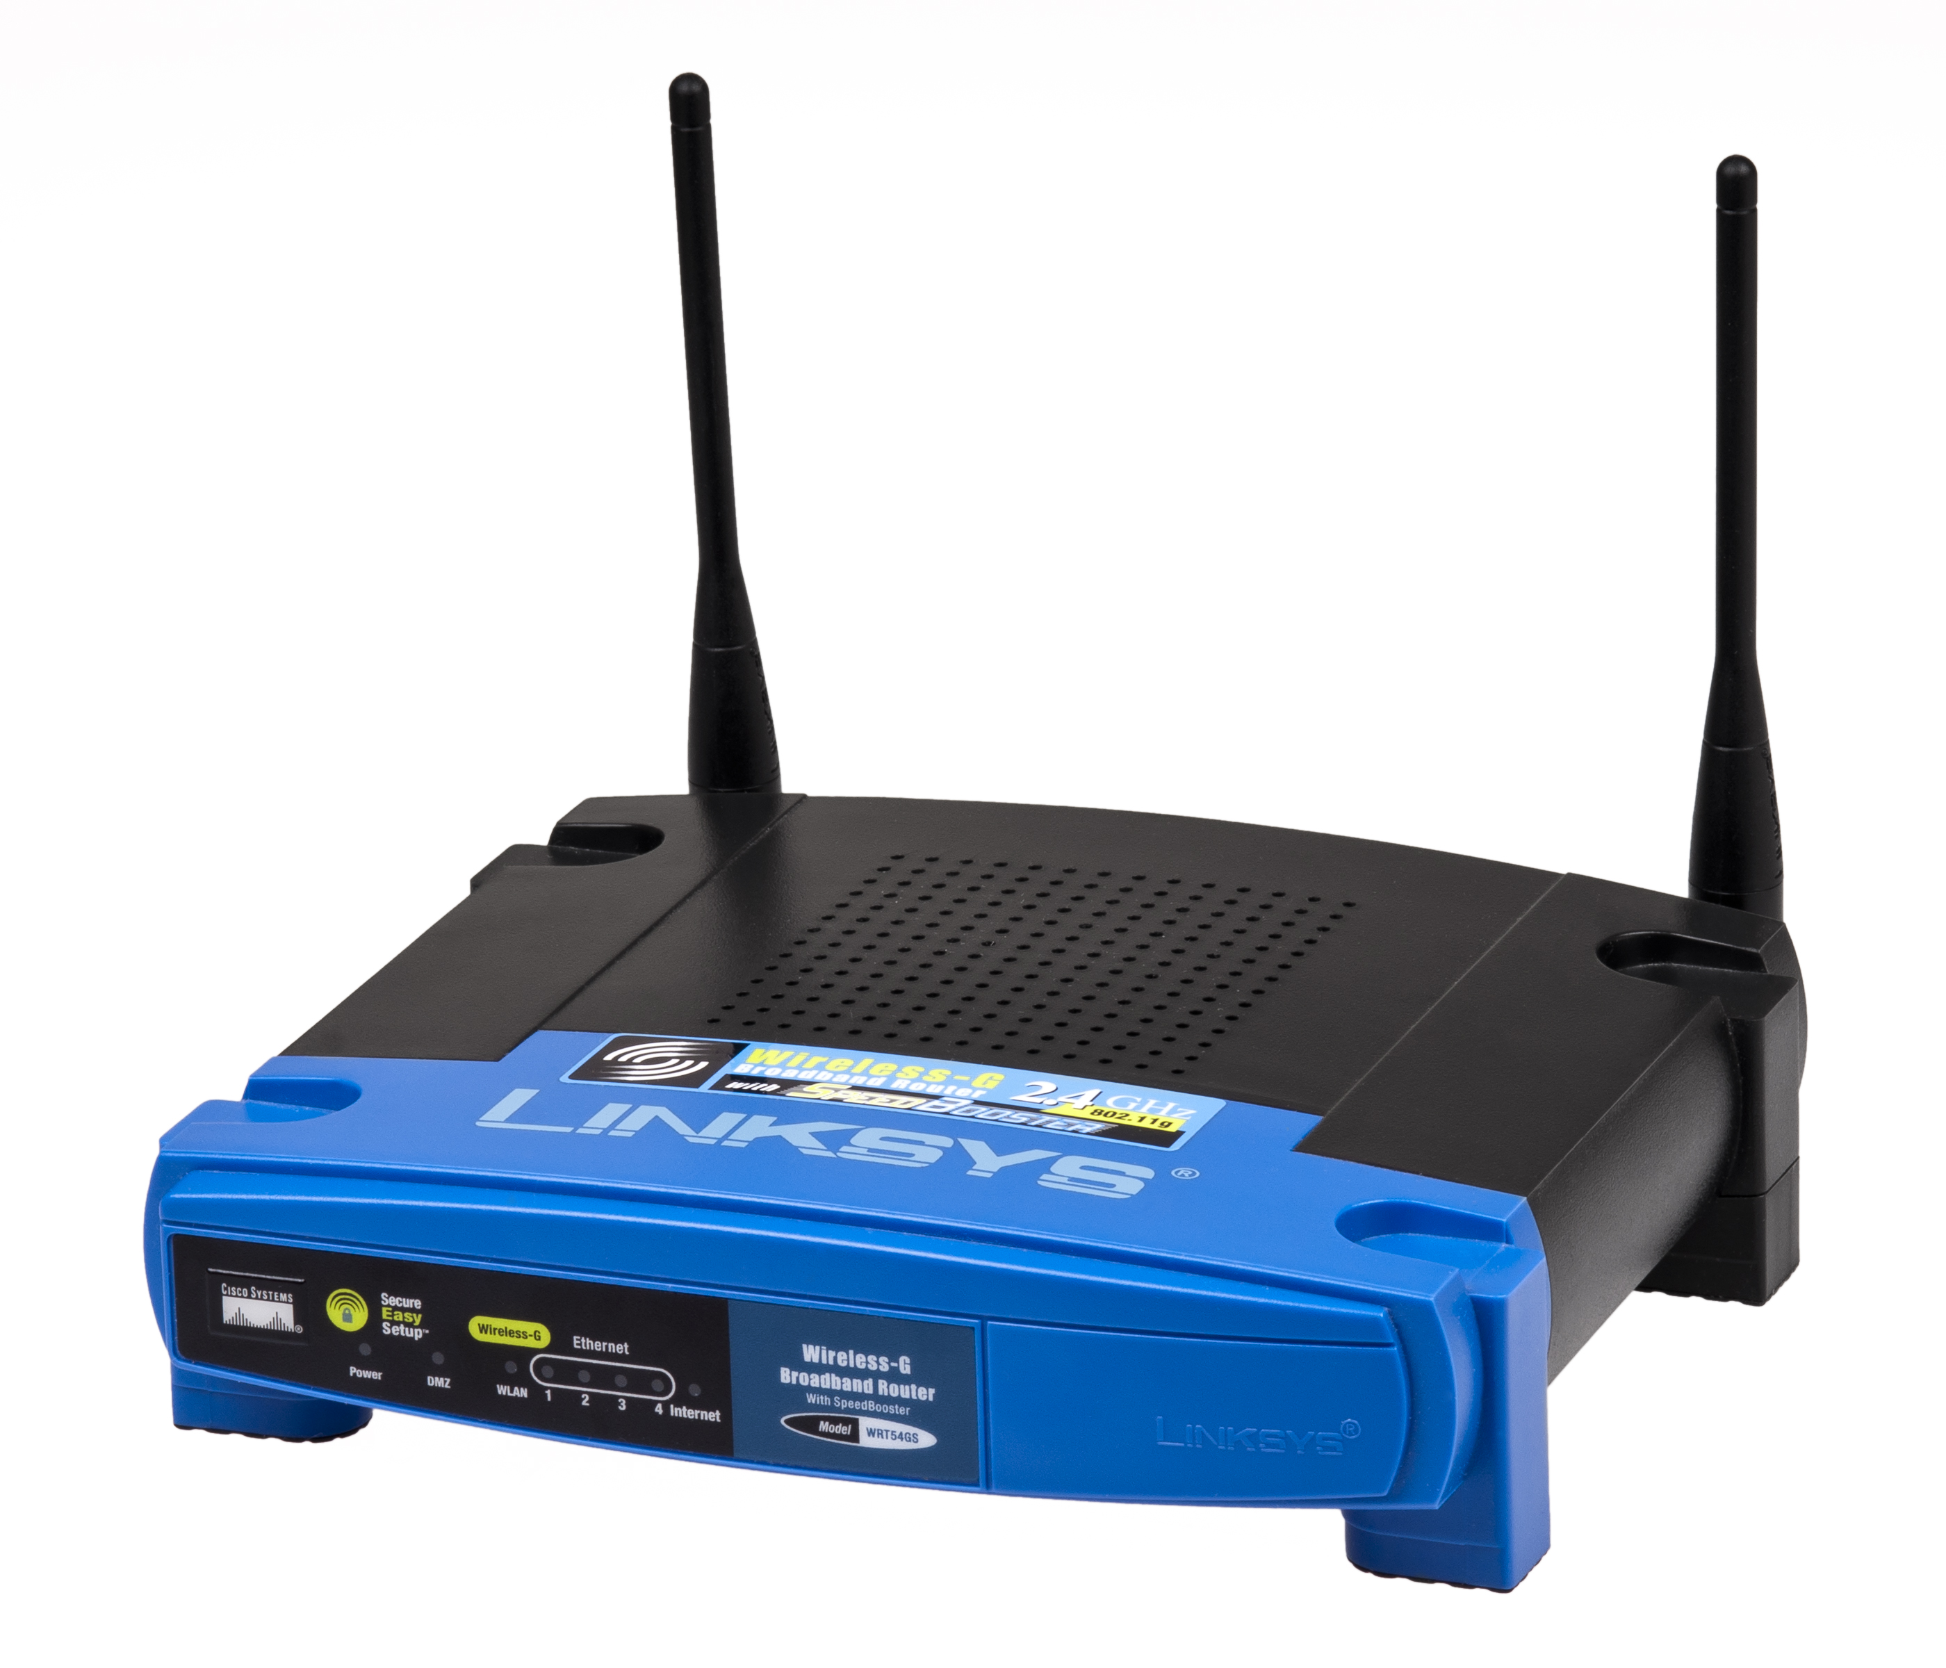


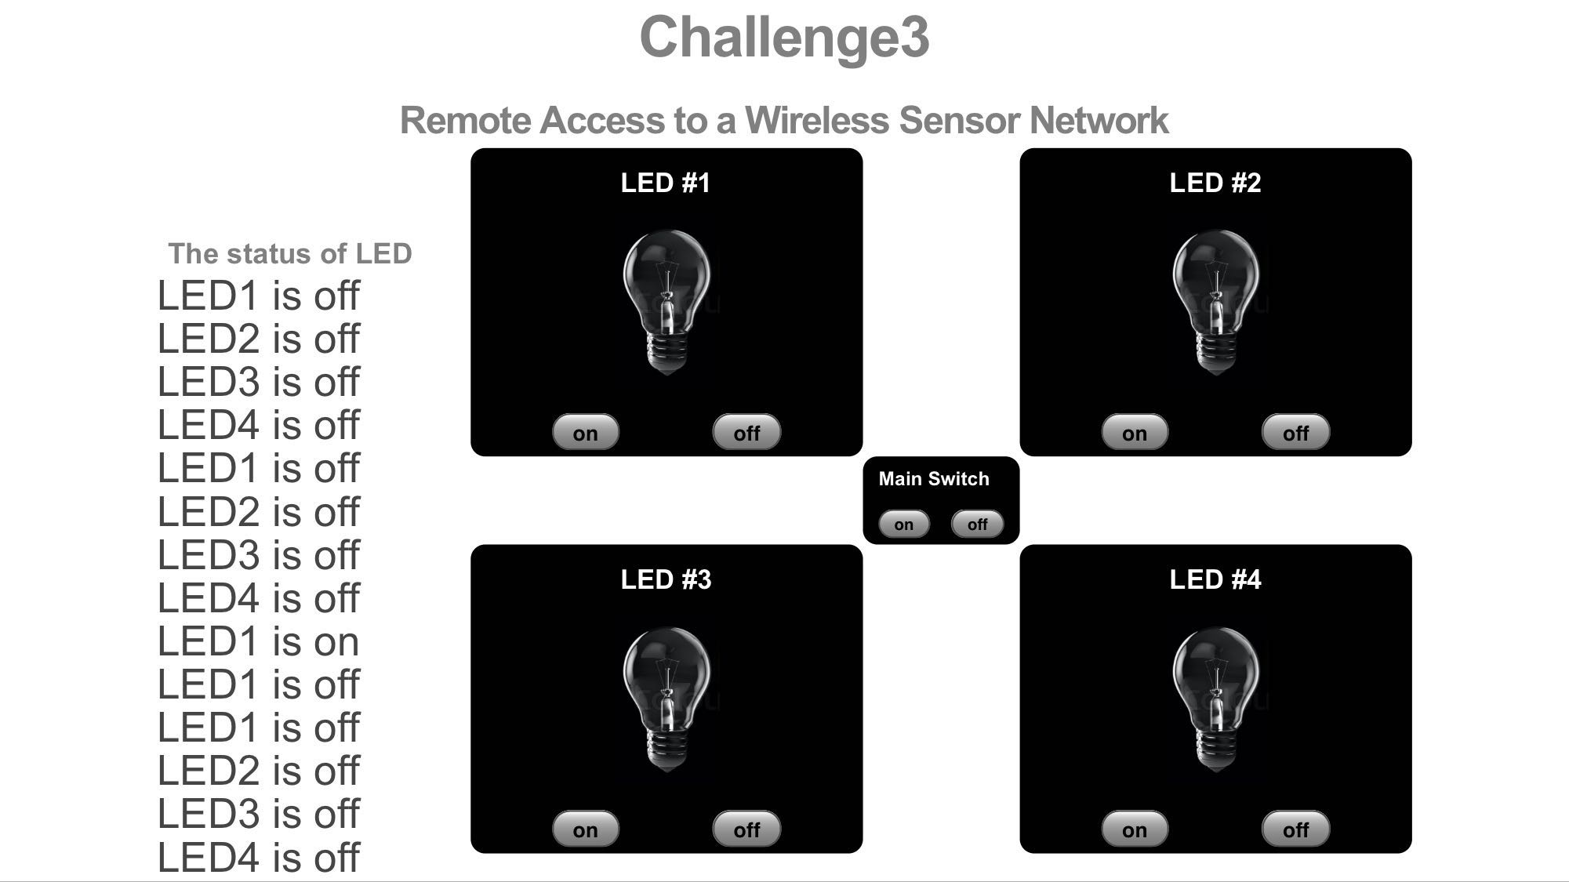
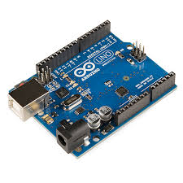
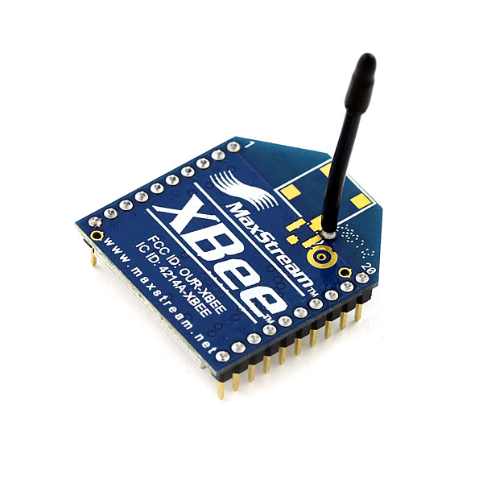
architecture
EC544.ddns.net
1234
Localhost 3000
Send data
Receive data

Slide 5
Unidirectional data flow from remote terminal to local device network
Data Flow:
Website → Network → Router → Pi → Xbee → Arduino
Remote Access: DDNS:
Provide a domain which is easy to access
Set a static IP

Slide 6
Bidirectional data exchange
Each time we reload the website, the lights will reset (shut down)
Using socket.io to send data from client to Arduino by Xbee.read()
After the lights’ status change, using Xbee.println() to send back the responding message

Slide 7
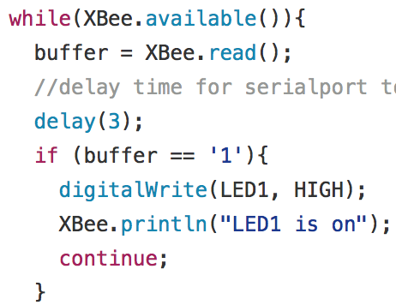
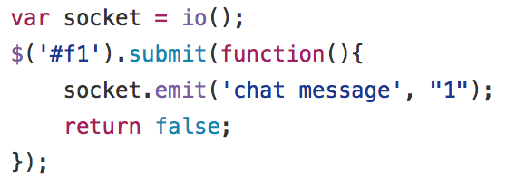
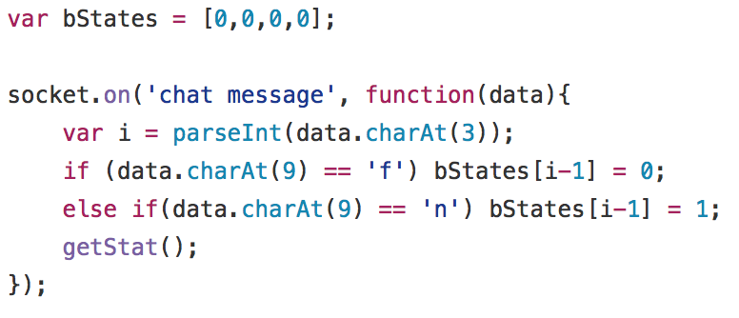
For example. we send a request from javascript to xbee to set led1 HIGH, then it will send back a message “LED1 is on” .Finally by distinguishing the character of that message, we can set the led status on web page.

Slide 8
Challenge
Set up DDNS
Implement the bidirectional data exchange
Combine all these things together and make them work

Slide 9
Thank you !

